Slide 1
Log Centric Systems, RAFT, and Science Gateways
Managing distributed logs with consensus

Slide 2
Some Highly Recommended References
“The Log: What every software engineer should know about real-time data's unifying abstraction”
Jay Kreps
https://engineering.linkedin.com/distributed-systems/log-what-every-software-engineer-should-know-about-real-time-datas-unifying
“In search of an understandable consensus algorithm”
Diego Ongaro, John K Ousterhout
https://www.usenix.org/system/files/conference/atc14/atc14-paper-ongaro.pdf
“The RAFT Consensus Algorithm”
http://www.andrew.cmu.edu/course/14-736/applications/ln/riconwest2013.pdf
Diego Ongaro and John Ousterhout

Slide 3
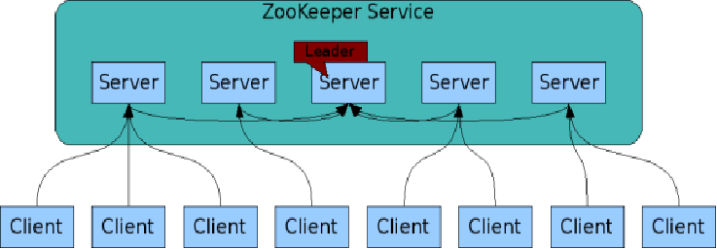
The ZooKeeper Service
Zookeeper is itself an interesting distributed system
These are your microservices
ZooKeeper Service is replicated over a set of machines
All machines store a copy of the data in memory (!)
A leader is elected on service startup
Clients only connect to a single ZooKeeper server & maintains a TCP connection.
Client can read from any Zookeeper server.
Writes go through the leader & need majority consensus.
https://cwiki.apache.org/confluence/display/ZOOKEEPER/ProjectDescription

Slide 4
Kafka Uses Clusters of Brokers
Kafka is run as a cluster of brokers on one or more servers.
Kafka uses Zookeeper to manage state of clients and leadership of brokers.

Slide 5
But First, a Queue-Centric Design
RabbitMQ’s Work Queue Tutorial Example
A publisher puts work in a queue
The broker distributes it to consumers in round-robin fashion
The consumers send ACKs after they have processed the message
Consumers can limit the number of messages they receive.

Slide 6
Some Features and Considerations for Queue—Centric Systems
If a consumer crashes before sending an ACK, the broker will resend the message to another consumer, if one is available
But detecting a failed consumer is a fundamentally hard problem
See next slide
These are corner cases until you have a major network disruption, then these cascade all at once
A resent $1B transaction is a catastrophe
It is possible that the broker can acquire a backlog of un-ACK’d messages, hindering performance
What if the broker crashes?
RabbitMQ provides some persistency mechanisms, but are these first class design considerations?

Slide 7
Issue | Solution
Consumer crashes | Broker detects the crash using a heartbeat. This works well for small systems (Zookeeper) but doesn't scale. See Gossip Protocol
Consumer is very slow | Heartbeat detects that the consumer is alive but taking a very long time to send an ACK. Solution: use a time out. The broker needs to tell the consumer to stop processing the message, complicating the implementation. Time outs need to be selected correctly.
Consumer is temporarily inaccessible | Consumer A doesn’t crash but the heartbeat fails. The broker resends the message to Consumer B. Then network returns and Consumer A sends the ACK. The message got processed twice.
Broker is temporarily inaccessible | The broker’s host server is temporarily off the network. The broker thinks all un-ACK’d messages are lost and so re-queues them. It will want to redeliver them when it detects consumers are available again, but then a cascade of ACKs will arrive. How do you handle this?
Some issues with detecting failed message delivery

Slide 8
Towards a Log-Centric Architecture: Logs, Queues, and Logs
OK, how about “error messages, messaging messages, and recorded messages”?

Slide 9
Application Logs
The info, warning, error, and other debugging messages you put into your code.
Very useful for detecting errors, debugging, etc.
Consolidation is critical in distributed systems: ELK stack
Human readable, unstructured format

Slide 10
Message Queues
Message Queue: a data structure containing a consumable list of entries.
Publishers create entries
Brokers receive and deliver entries
Consumers consume entries
Entries are machine readable.
Entries are removed when they are consumed.
We discussed these limits in the Kafka lectures: queues are not good for replays --> state management

Slide 11
The Other Type of Log: State Records
Logs: records of state changes in a system
Machine readable
Distributed logs -> distributed state machines
Logs can be for internal consumption
Enables a system to recover state on restart or failover
Ex: Zookeeper and Kafka internals
Logs can be for external consumption
Different types of processes share a state machine: same logs are processed differently
Messaging
Ex: Clients to Zookeeper, Kafka
Kirk records a message in case Spock needs to take over.

Slide 12
Example: MySQL Dump
You can use MySQL’s dump command to create a restorable version of your DB.
These are logs
What if you needed to restore lots of replicated databases from the same dump?

Slide 13
Logs and Queues
These are similar data structures
Basics: First in, first out
Important difference is that logs are persistent while queue entries are transient
Persistence can have limits: Kafka quality of service
Message queue: the broker often needs to know if the message was delivered and processed correctly
Is it safe to delete an entry?
ACK or NACK
Stateful
Log system: client is responsible for knowing the last entry it consumed
The broker just keeps track of the records
Stateless, or REST-like, interactions with clients (idempotent)

Slide 14
Some Desirable Properties of State Logs
Property | Description
Ordered | Logs record state changes, so they must be in sequence
Correct | We are confident that a log entry was recorded correctly
Complete | There are no missing records between the first and last entry
Machine Readable | Log entries are serialized data structures, operations
Persistently Stored | The logs are stored on highly stable media
Available | Applications that depend upon the logs can get them

Slide 15
High Availability Requires Log Replication
There must be a failover source of logs if the primary source is lost.
Weak consistency may be OK: a replica may be behind the primary copy, but otherwise, they match exactly
Consensus algorithms address this problem
Paxos is the most famous consensus algorithm
Lamport, L., 1998. The part-time parliament. ACM Transactions on Computer Systems (TOCS), 16(2), pp.133-169.
But it is hard to understand and implement
Zookeeper and Chubby, for instance, don’t use it

Slide 16
Raft Consensus Protocol
Raft has been developed to provide a more comprehensible consensus protocol for log-oriented systems
Several implementations
https://raft.github.io/
See also http://thesecretlivesofdata.com/raft/
It is similar to but simpler than Zookeeper’s Zab protocol
Ongaro, D. and Ousterhout, J.K., 2014, June. In search of an understandable consensus algorithm. In USENIX Annual Technical Conference (pp. 305-319)
I’ll use some slides from https://raft.github.io/

Slide 17
Properties of Consensus Systems
Property | Description
Safety | Never return incorrect results to queries
Availability | The system functions as long as a majority of servers are operational
Ordered Messages | Message order does not depend on system clocks, slow networks are not a problem
Majority Commits | Logs are recorded if a majority of members accepts the write. Don’t need to wait on complete consensus.

Slide 18
Raft Basics: Strong Leader and Passive Followers
Raft systems have a strong leader
The leader service/broker accept write requests from clients
Follower-brokers redirect write requests from clients to the leader broker
Like Zookeeper
The leader sends updates to logs to all followers
If a majority of followers accept the update, the leader instructs everyone to commit the message.
A minority of followers can have fewer committed messages than the leader at any given time, but they must always consistent

Slide 19
Replicating databases
RAFT Follower
RAFT Follower
RAFT Leader
RAFT Follower
RAFT Follower
Microservice Client
Microservice Client
Microservice Client
Microservice Client

Slide 20
Leaders and Leadership Changes
There is at most one leader at any time
A system needs a new leader if the leader fails or becomes disconnected from a majority of followers
Heartbeat failures
New leaders are chosen by election from among the followers
Followers become candidates if they detect that a leader has failed
Only one candidate can win
A term is the period of time a particular leader is in charge

Slide 21
timeout, new election
timeout, start election
receive votes from majority of servers
start
Raft Server States:
Follower
Candidate
Leader
“step down”
discover server with higher term
Term 1
Term 2
Term 3
Term 4
Term 5
Raft Time Evolution:
time
Elections
Split Vote
Normal Operation

Slide 22
Key Raft Properties
Election Safety: At most, only one leader can be elected
Leader Append-Only: Leaders can only append entries to their logs. They never overwrite old entries.
Log Matching: if two logs have the same index and same term, then the logs are identical in all entries up to that index
Leader Completeness: If a log entry is committed in a given term, then the entry will appear in the logs of leaders of future terms
State Machine Safety: if a server has applied an entry, no server will ever overwrite this entry
Desirable qualities, but how do we implement it?

Slide 23
Logs and Committed Logs
Servers can have log entries that are volatile
Log entries are only committed after a majority of servers have accepted the log message.
Committed logs are guaranteed
Clients only get acknowledgements about committed log entries

Slide 24
Log Structure
term
1
2
3
4
5
6
7
8
log index
1 add
1 cmp
1 ret
2 mov
3 jmp
3 div
3 shl
3 sub
leader
command
1 add
1 cmp
1 ret
2 mov
3 jmp
1 add
1 cmp
1 ret
2 mov
3 jmp
3 div
3 shl
3 sub
followers
1 add
1 cmp
1 add
1 cmp
1 ret
2 mov
3 jmp
3 div
3 shl
committed entries
Log entry = index, term, command
Log stored on stable storage (disk); survives crashes
Entry committed if known to be stored on majority of servers
Durable, will eventually be executed by state machines

Slide 25
Raft Election Process
Leaders send heartbeat messages periodically
If a follower doesn’t receive a heartbeat during an “election timeout” period, it changes to a candidate.
The candidate votes for itself
The candidate sends RequestVote messages to all other servers
Candidate sends its term and index
If a server is in follower state, it votes for the candidate
If the server is in candidate state and has a term and index < the other candidate’s, it reverts to follower state and votes for the candidate
When a candidate receives votes from a majority of servers, it wins the election and becomes the new leader

Slide 26
Election
1
2
3
4
5
6
7
8
log index
1 add
1 cmp
1 ret
2 mov
3 jmp
3 div
3 shl
3 sub
Old leader
C1
1 add
1 cmp
1 ret
2 mov
3 jmp
C2
1 add
1 cmp
1 ret
2 mov
3 jmp
3 div
3 shl
3 sub
Candidates 1, 2, 3, 4
C3
1 add
1 cmp
C4
1 add
1 cmp
1 ret
2 mov
3 jmp
3 div
3 shl
committed entries
Candidates C2 and C4 can win the election with 3 votes
Candidates C1 and C3 will vote for either
Candidate C4 can win if gets votes from C1 and C3 before contacting Candidate 2
Note a split election is possible: Candidate 1 votes for Candidate 2, and Candidate 3 votes for Candidate 4
Log entry 8 was not committed, but that’s ok: the client hasn’t received an acknowledgement

Slide 27
Split Elections
If no candidate receives a majority of votes, the election fails and must be held again.
Raft uses random election timeouts.
If a leader hasn’t been elected within the time out, a candidate increments its term and starts a new election.
Each server has a different time out, chosen at random.
Typically, only one server at a time will be in candidate state
This randomness is key for the system to find a new leader quickly

Slide 28
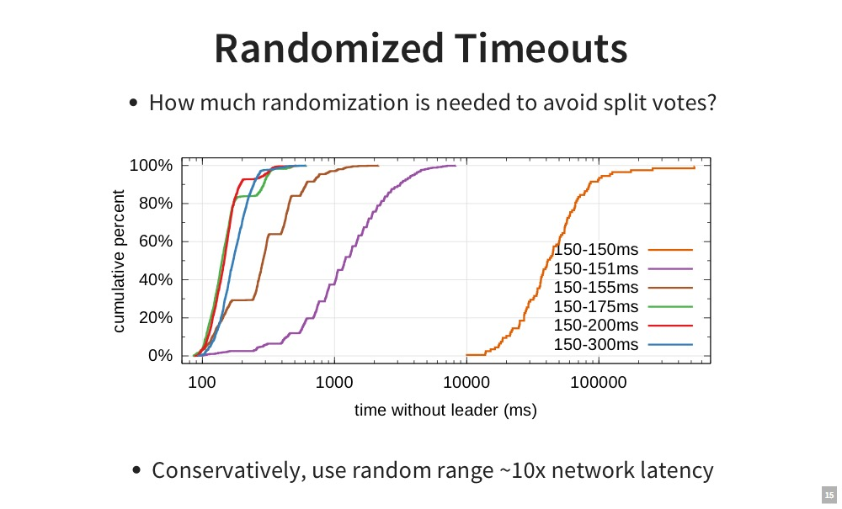

Slide 29
New Commitment Rules
For a leader to decide an entry is committed:
Must be stored on a majority of servers
At least one new entry from leader’s term must also be stored on majority of servers
Once entry 4 committed:
s₅ cannot be elected leader for term 5
Entries 3 and 4 both safe
1
2
3
4
5
s₁
1
1
2
4
Leader for term 4
s₂
1
1
2
4
s₃
1
1
2
4
s₄
1
1
s₅
1
1
3
3
3
Combination of election rules and commitment rules makes Raft safe

Slide 30
Log Inconsistencies
Leader changes can result in log inconsistencies:
log index
1
2
3
4
5
6
7
8
9
10
11
12
leader for term 8
1
1
1
4
4
5
5
6
6
6
(a)
1
1
1
4
4
5
5
6
6
Missing Entries
(b)
1
1
1
4
(c)
1
1
1
4
4
5
5
6
6
6
6
possible followers
(d)
1
1
1
4
4
5
5
6
6
6
7
7
Extraneous Entries
(e)
1
1
1
4
4
4
4
(f)
1
1
1
2
2
2
3
3
3
3
3

Slide 31
Repairing Follower Logs
New leader must make follower logs consistent with its own
Delete extraneous entries
Fill in missing entries
Leader keeps nextIndex for each follower:
Index of next log entry to send to that follower
Initialized to (1 + leader’s last index)
When AppendEntries consistency check fails, decrement nextIndex and try again:
nextIndex
log index
1
2
3
4
5
6
7
8
9
10
11
12
leader for term 7
1
1
1
4
4
5
5
6
6
6
(a)
1
1
1
4
followers
(b)
1
1
1
2
2
2
3
3
3
3
3

Slide 32
Repairing Logs, cont’d
When follower overwrites inconsistent entry, it deletes all subsequent entries:
nextIndex
log index
1
2
3
4
5
6
7
8
9
10
11
leader for term 7
1
1
1
4
4
5
5
6
6
6
follower (before)
1
1
1
2
2
2
3
3
3
3
3
follower (after)
1
1
1
4

Slide 33
Neutralizing Old Leaders
Deposed leader may not be dead:
Temporarily disconnected from network
Other servers elect a new leader
Old leader becomes reconnected, attempts to commit log entries
Terms used to detect stale leaders (and candidates)
Every RPC contains term of sender
If sender’s term is older, RPC is rejected, sender reverts to follower and updates its term
If receiver’s term is older, it reverts to follower, updates its term, then processes RPC normally
Election updates terms of majority of servers
Deposed server cannot commit new log entries

Slide 34
Client Protocol
Send commands to leader
If leader unknown, contact any server
If contacted server not leader, it will redirect to leader
Even for READS
Compare with Zookeeper
Client guaranteed to get latest committed log state, but Raft doesn’t scale as well
Leader does not respond until command has been logged, committed, and executed by leader’s state machine
If request times out (e.g., leader crash):
Client reissues command to some other server
Eventually redirected to new leader
Retry request with new leader

Slide 35
Raft and Configuration Changes (Brief)
Raft’s consensus approach requires that a leader never gives up on unreachable servers.
Quasi-static collections of servers
Raft can also handle situations in which new servers are added to the system and old servers are cleanly removed.
It does this by requiring joint consensus between the old and new collections.
New servers are non-voting members until they have come up to speed.
This is an interesting approach for handling Continuous Deployment scenarios.
More in a future lecture

Slide 36
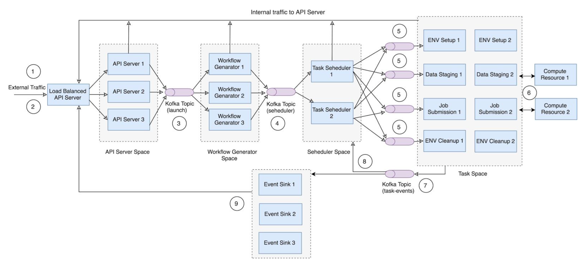
A log-based approach for executing Apache Airavata workflows with Kafka

